Slide 1

Stock Price Prediction
Group 17
HKUST
2017/05/05

Slide 2
Outline
Problem Introduction
Model Comparison
Backtesting
Future Work
Conclusion

Slide 3
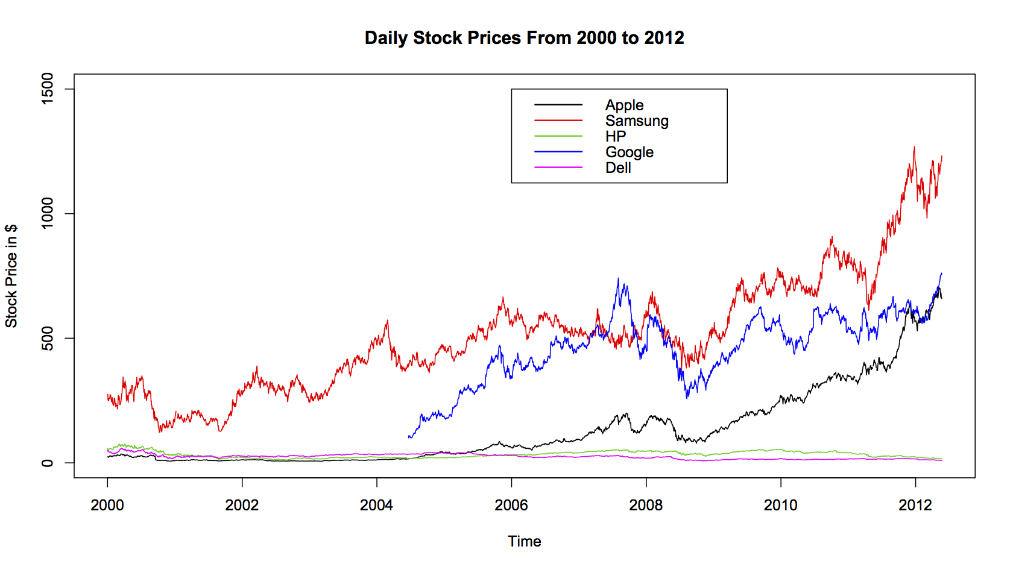
Problem Introduction
Motivation
As we all known, stock price prediction is always a hot and unsolved topic, we are all interested in stock trading and wonder if we could make accurate predictions using machine learning methods.

Slide 4
Problem Introduction
What we did in this project
In this project, we
Preprocessed raw data of hundreds of stocks
Trained three three machine learning models to learn the rules of each single stock
Linear Regression
BP Networks
Convolutional Neural Networks
Backtested on simulated stock market using predictions of the best model out of the above three

Slide 5
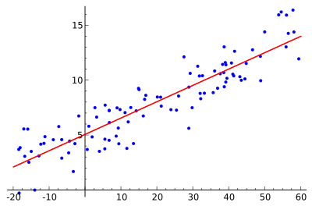
Model Comparison
Linear regression
In this model, we choose the close prices of last 15 days as our input to predict the price change ratio of next day.

Slide 6
Model Comparison
Linear regression
MSE: 0.015

Slide 7
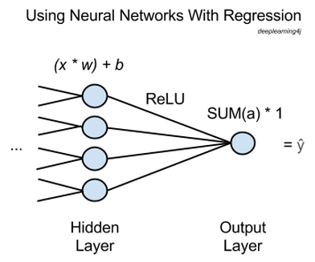
Model Comparison
Neural networks
Neural networks are used for the purpose of unsupervised learning , classification, or regression. That is, they help group unlabeled data, categorize that data or predict continuous values after supervised training.
Like the linear model we mentioned before, in our model, we also choose the last 15 day close price as our input.

Slide 8
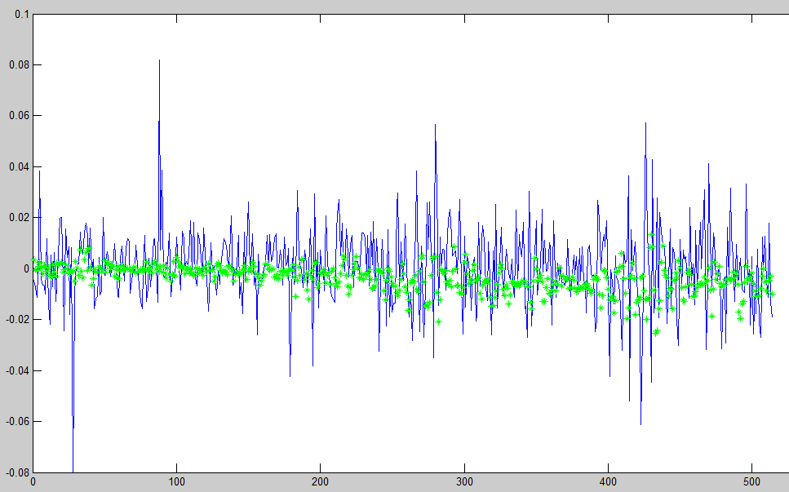
Model Comparison
Neural networks
MSE: 0.0002

Slide 9
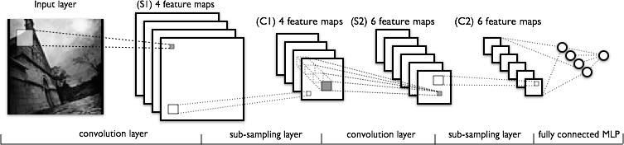
Model Comparison
Convolutional Neural Networks
In this model, we use TP matrix as input because CNNs processes 2 dimensional data.
And TP matrix has been proved useful in financial area.

Slide 10
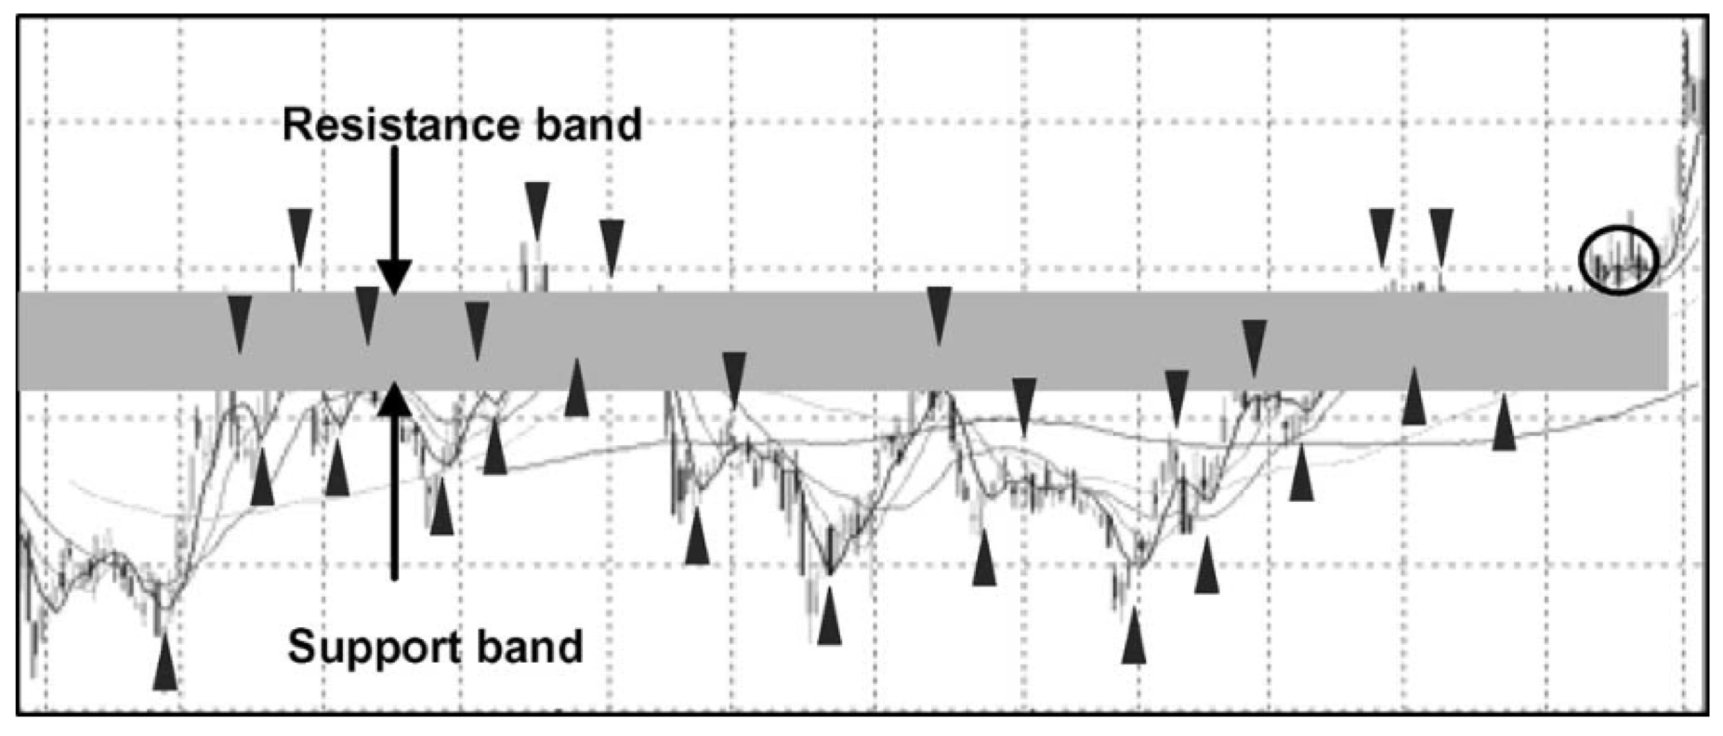
Model Comparison
TP(local extremal point in the plots generated by computing five-day MAs of closing prices)
Notes:
Nounce In finance,
Downward TP(local maximum) suppress the rise of stock price
Upward TP(local minimum) means there will be a rising trend in the future

Slide 11
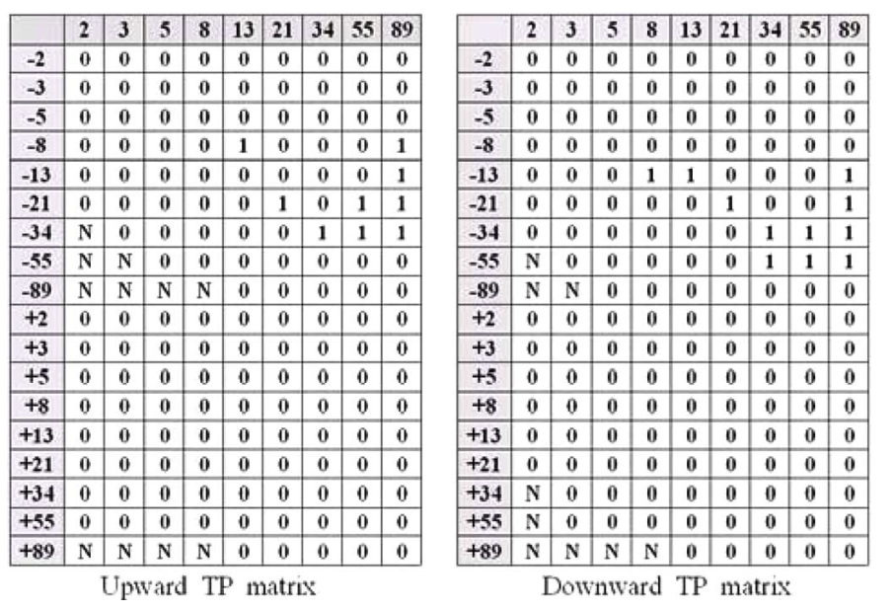
Model Comparison
TP Matrix
It can summarise the history of stock price changes over a long period.
Notes:
Long period: 230 years
Summary of history TP information
Column stands for time window, the number means how many days you should go back to the history.
Row stands for price change range and they are percent numbers
They both use Fabonaci numbers, which emphasis more on the closer data than the farther data in the history.
Binary matrix,
An element in the matrix means, whether or not the stock has a change ratio in a certain range and in a certain time window in the history

Slide 12
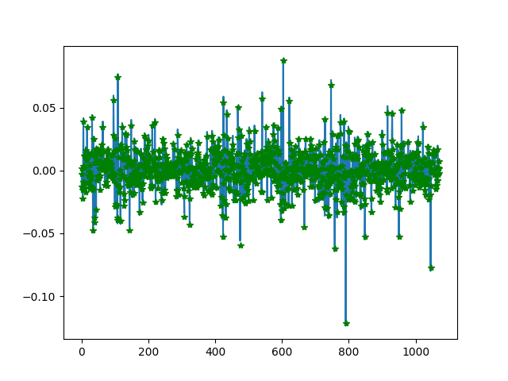
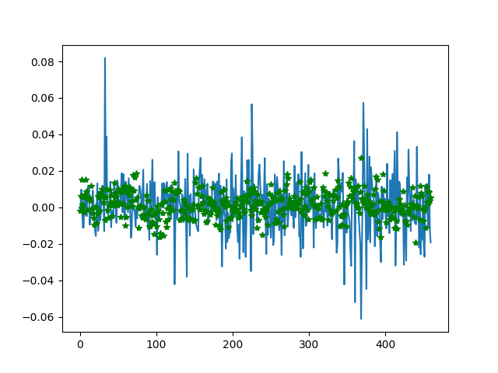
Model Comparison
CNNs
Training set
MSE: about 10⁻⁷
Test set
MSE: about 10⁻⁵

Slide 13
Back testing
For one single stock, on the morning of each trading day, we use the model to predict the price change ratio.
If the output is large enough(larger than a certain threshold), we buy the stock with all money.
If the output is small enough(smaller than another certain threshold), we sell all of our shares.
Otherwise, we just take the "hold" action and do nothing.
Here, we used data mining to find two proper thresholds of “buy” and “sell”.

Slide 14
Back testing
Annual profit: 93.47%
Also good max drawdown and sharpe ratio
Notes:
m

Slide 15
Future Work
Try different kinds of inputs
Involve more information besides stock price
Go on modifying our model
Try classification methods on this problem
Predict “rise” or “fall” of stock price

Slide 16
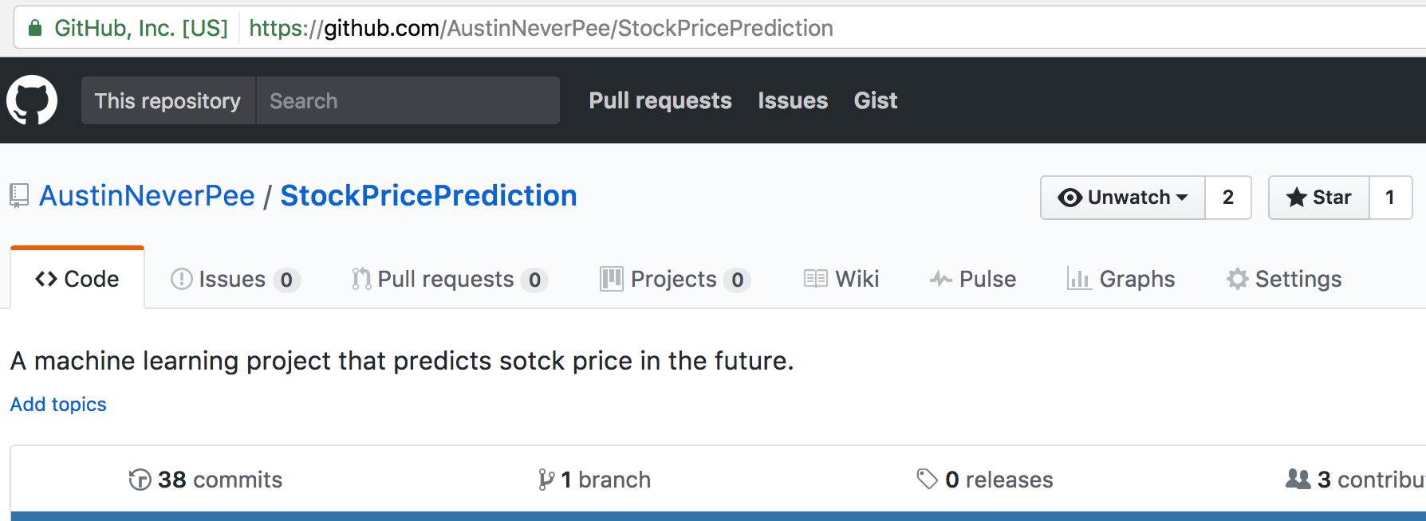
Conclusion
Machine learning is so popular not only in the area of traditional computer science.
Stock market is complex but beautiful and absolutely worth a try.
We’ll keep updating our project on Github. Keep eyes on us if you are interested!

Slide 17

THANKS
FOR WATCHING

